Slide 1




Become a Contributor to Microsoft Docs

Slide 2

Agenda
Introductions
Rogue One in DevRel
Tips & Tricks:
Article Navigation and Versioning
Help in SSMS
Microsoft Docs in Github
Docs.Microsoft.com is Open Source
The Github Workflow
How to Contribute
Product feedback, Issues, and PRs
Don’t be Afraid to Submit a PR!
What’s new in SQL Docs?
Open discussion and Q&A
Notes:
Here’s today’s agenda. We’re going to make introductions to the SQL Docs team ([if applicable] including the members here today),
talk about what we cover and how we work with the product teams,
And most importantly how to contribute to SQL Docs through Github, and what you need to know.
Then we’ll leave plenty of time for feedback and Q&A.

Slide 3
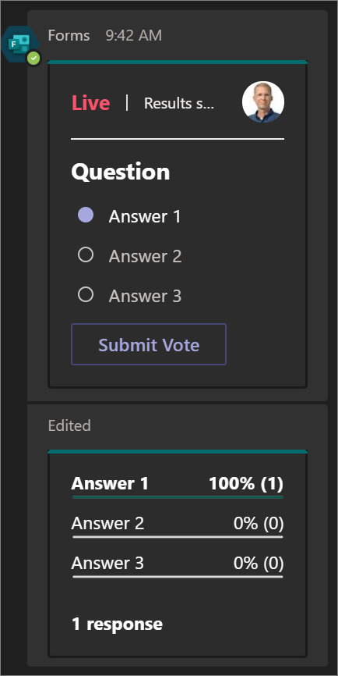
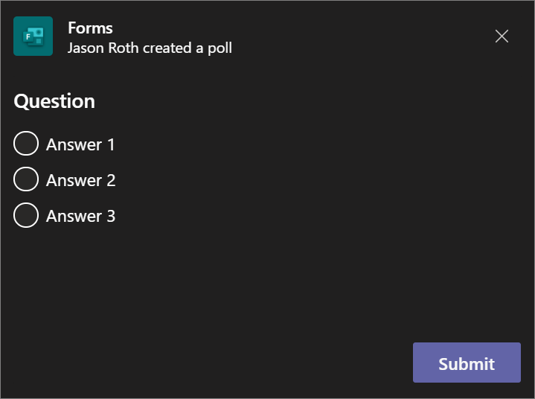
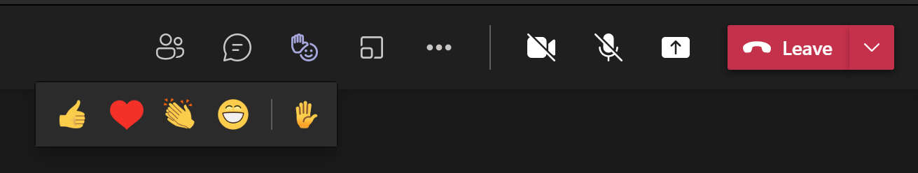
Who are you?
Throughout the focus group we’ll launch polls in teams to learn more about you and what you think.
Popup
In Meeting Chat
At any time, use the hand-raise feature or just speak up to ask a question or make comment:
Notes:
<optional slide>
Poll: What is your role?
Poll: How often do you use SQL documentation on docs.microsoft.com?

Slide 4

Introductions
Notes:
We’re the SQL Docs team, affectionately internally nicknamed Rogue1, and while we’re not violating multiple copyright laws with that image, we support tens of thousands of articles about SQL Server.
In the Microsoft Developer Relations group there are over 600 folks working to deliver documentation and learning content for all Microsoft technologies, working closely with our partners in product teams to release, augment, and maintain documentation.

Slide 5

SQL Docs: Who are we?
SQL documentation team covering for:
SQL Server
All flavors of Azure SQL
Azure Synapse Analytics (including BDC, dedicated SQL Pool (SQL DW)
SQL tooling (SSMS, Azure Data Studio)
Azure ARC for Data Services
Notes:
So what technologies does the SQL Docs team cover?
We work with the product groups and program managers for everything SQL Server, including all its various flavors in Azure, as well as Azure Synapse Analytics and the technologies under that umbrella. We also cover content for data platform tooling including SSMS, Data Tools, Azure Data Studio.
We work and communicate daily with the product team engineers and Program Managers,
both proactively when we have issues or pull requests that come from you in the community,
and for issues and requests that come in via Microsoft support and cloud solution architects in the field,
and reactively when they come to us with new features and releases for products that need new documentation.
We work collaboratively to make sure we have new content that is correct, up to date, well linked, with good metadata and navigation.
This content includes the conceptual and reference docs, but also quickstarts, tutorials, and FAQs. We work with them to time document releases with their product release trains.
We often end up working more with product teams than with each other. It’s nice when we get to work together on a presentation like this! [introduce SQL Docs team members present and their areas over coverage]

Slide 6
What is DevRel?
Areas of ownership
Documentation
Introductory thru expert level
Reference (ex: API docs, code samples)
Community interaction
Bugs, suggestions, feedback
Technical background
Strategic advantage
Enhance adoption
Authentic community engagement
Connecting with YOU
Notes:
The SQL Docs team is one of many Docs teams for different products in Microsoft’s Cloud + AI DevRel team.
What is DevRel?
In a greater role, DevRel is the team that involves activities that connect developers and in-house manufactured goods/services with external users. DevRel ensures that products establish a good, continuous relationship with external developers through mutual communication.
DevRel definitely involves documentation, including user-friendly explanations, but also reference documentation for how to call APIs, how to install and configure, code samples.
DevRel in other companies might also look like: community management, issue reporting and triage, release notes, focus groups, and public interaction. Your favorite video game for example has DevRel folks to send and receive communication with the public about bug reports, troubleshooting, patch notes, manage discussion boards, feature requests, mods development, and community events.
DevRel folks are technical and know the products well. In fact, some tech companies cycle developers in and out of DevRel positions so that DevRel folks have a keen awareness of technical detail, but also, so that Developers see how the end user consumes the products and the communication.
In DevRel we also work with issue reports and suggestions from the community. We communicate directly with people in the community suggesting edits to docs. That means you!
At Microsoft, the hundreds of Content Developers on our DevRel teams usually have a strong technical background from consulting or support positions. Most folks on our team came from Microsoft field support or consulting departments or had product expertise outside Microsoft. Most also have some experience with project management, technical writing, blogging, or book writing. And some of us even have English degrees!
DevRel also includes Cloud Developer Advocates, senior technical folks in a developer evangelism role who meet customers, present at events, but also help us shape better Docs and Learn content.
Finally, DevRel is a strategic advantage for product teams because this type of outreach enhances adoption and integration, and provides authentic community engagement that goes beyond marketing and social media. Microsoft feels like its DevRel is a strategic advantage over competitors especially in terms of our team’s products, the SQL offerings. You’ll measure this by how well our docs answer your questions and provide explanation for your problems.
In a way, DevRel is not marketing to CIOs and CEOs, it’s marketing to developers and technical folks like you. There are products out there we’ve all used and continued to use because of good documentation and support experiences, because of easy adoption and smooth learning curves.
So in that spirit of authentic community involvement, let’s dive into how you can contribute to Microsoft Docs! There are hundreds of thousands of GitHub issues and PR’s submitted to Docs every month, how can you be an effective part of that process and get your face on the top of an article?

Slide 7
Tips & Tricks
Notes:
Alright let’s talk about Microsoft Docs and how you use them.

Slide 8
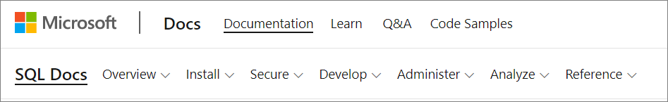
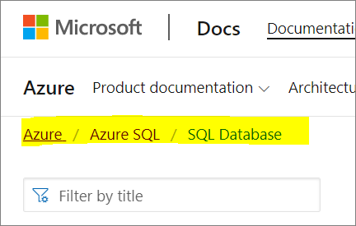
Navigation: Headers & Breadcrumbs
Header:
Navigation bar for quick access to SQL content
Breadcrumbs:
At the top of the page that allows you go to back to a higher level landing or hub page:
Notes:
Just a heads up on some features of the Docs.Microsoft.com site. The navigation bar at the top and the breadcrumbs menu should always let you know where you are, and how to move around.

Slide 9
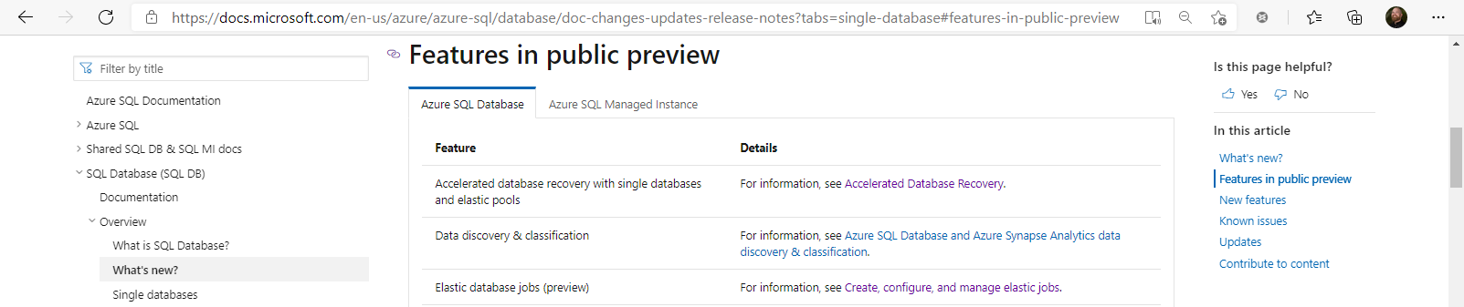
Doc Navigation
Lots more about docs navigation here: SQL Server docs navigation tips - SQL Server | Microsoft Docs
Notes:
Just to give you a map around navigating specific docs,
<click>
The table of contents on the left covers many different articles, and it is here that it’s best to search inside a given technology stack.
<click>
On the right, you’ll see a navigation for the document itself.
<click>
Those header links are linkable directly, if you want to send a colleague a link to a heading specifically. Or you can cover on a heading, see the link graphic appear, and copy the URL with the page anchor appended.

Slide 10
Doc Navigation Technology TOC
Notes:
Just to give you a map around navigating specific docs,
<click>
The table of contents on the left covers many different articles, and it is here that it’s best to search inside a given technology stack.
<click>
On the right, you’ll see a navigation for the document itself.
<click>
Those header links are linkable directly, if you want to send a colleague a link to a heading specifically. Or you can cover on a heading, see the link graphic appear, and copy the URL with the page anchor appended.

Slide 11
Doc Navigation TOC
Notes:
Just to give you a map around navigating specific docs,
<click>
The table of contents on the left covers many different articles, and it is here that it’s best to search inside a given technology stack.
<click>
On the right, you’ll see a navigation for the document itself.
<click>
Those header links are linkable directly, if you want to send a colleague a link to a heading specifically. Or you can cover on a heading, see the link graphic appear, and copy the URL with the page anchor appended.

Slide 12
Doc Navigation with Anchors
Notes:
Just to give you a map around navigating specific docs,
<click>
The table of contents on the left covers many different articles, and it is here that it’s best to search inside a given technology stack.
<click>
On the right, you’ll see a navigation for the document itself.
<click>
Those header links are linkable directly, if you want to send a colleague a link to a heading specifically. Or you can cover on a heading, see the link graphic appear, and copy the URL with the page anchor appended.

Slide 13
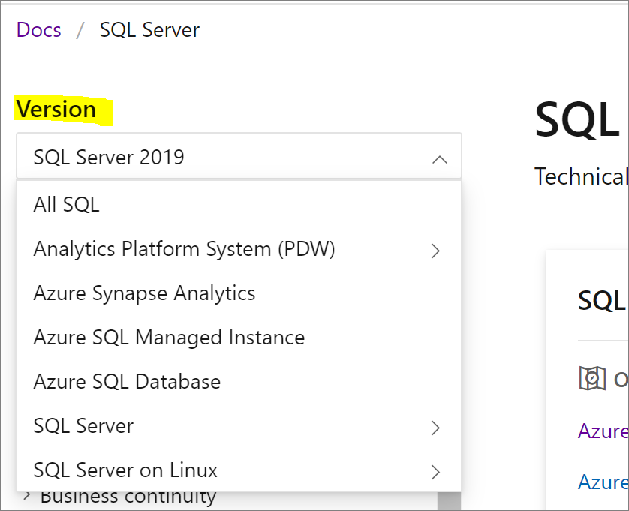
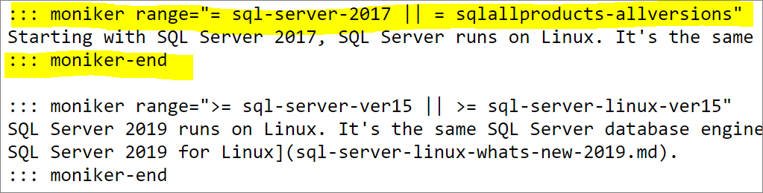
Versioning
Versioning drop-down targets a specific product/service
Changes what you see in an article
Varies depending on article design
“For SQL <=2014 content, the see the Previous versions article.
Notes:
Where it makes sense, the same doc might include different information for different versions of the product mentioned.
We may use the same article with various versions of content for Windows vs Linux, or different releases of SQL Server, or different Azure implementations of SQL Server. This on the bottom left is a code snippet of markdown showing how one article might display different content depending on the version requested.
If a doc doesn’t quite look right because of a version specific detail, take a look at the version you’re in, you can see this in the URL or in the header of the article if it’s got version-specific content.
Also note that for content that is specific to older versions of SQL Server before SQL Server, we do still have ways to access that old content, even if some of them are through offline docs only. Offline docs you say, like the old local Books Online reference documentation built into Management Studio? <next slide>

Slide 14
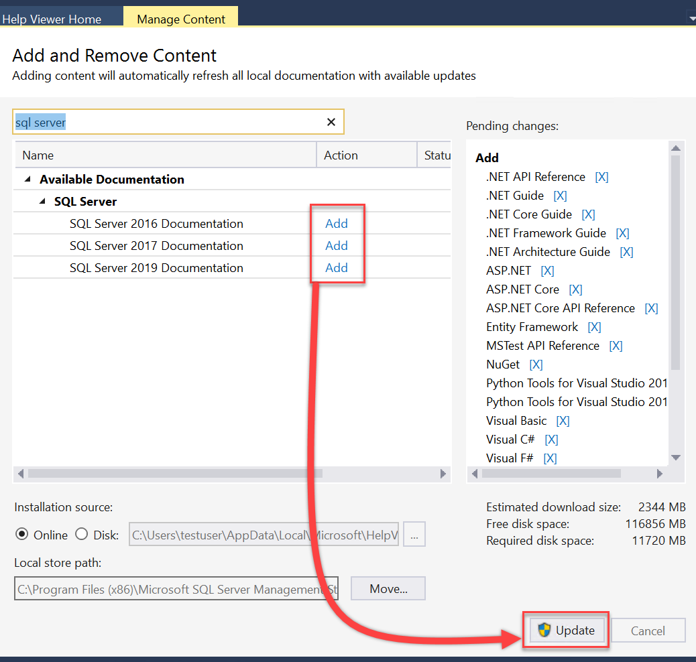
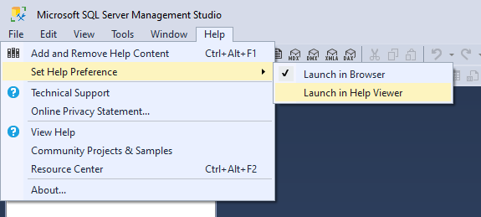
SQL Server offline help
Change Help Preference to “Help Viewer”
Offline SQL Server help
Notes:
If your work environment is behind an air-gapped network (and there are many reasons for this including the Microsoft-Department of Defense project), or if you work in high-security environments like a nuclear power plant, you can download version-specific docs offline through SSMS.
<Optional>Poll: How many of you work with offline help for SQL?
Our documentation is actually a strategic advantage against competitors. There are very large organizations, including public sector like the Department of Defense, and large private sector companies at the top of the Fortune list, that want their development environments internal and secured from the public internet. In the case of Microsoft’s documentation for SQL Server and Power BI and Azure and all sorts of other products, our documentation can easily be downloaded periodically and presented internally at those environments, so that they can get the best of both worlds – a secure network for development and access to fresh product documentation. Some of our competitors, no joke, want to deliver a few thousand PDF’s or zipped website scraped images or … well, c’mon it’s the 21st century!

Slide 15
F1
Notes:
Speaking of Management Studio, not a lot of people are still aware of this, but when you have any text highlighted and you hit F1 in SSMS, it should bring you right to the corresponding article for that word of syntax, for example.
If you have selected the Help Preference of “Open in Browser”, this will bring you directly to the Microsoft Docs Online article, in this case, for the dynamic management view sys.dm_exec_sessions.
If you hit F1 on something highlighted and it doesn’t bring you to a specific article, or to a different article than you’d expect, that might actually be a docs issue! And that’s something you could file an issue for.

Slide 16
How to Contribute
Notes:
So, how do you contribute to Microsoft docs? Whether you find something outdated, wrong, missing, needed or otherwise, what’s the best way to let Microsoft know?
There are three main ways.
1. Feeback
2. Issues
and, since the whole thing is inside Github, you can
3. create a Git Pull Request yourself, just as if you were contributing to an open source project.
<OPTIONAL> Poll the audience – how many of you have worked in Git and are familiar with terminology like fork, clone, push, pull, and commit? If you’re not, that’s ok!
Contributing can be done easily through the browser, without having to learn git bash or install anything, without having to know what a fork, clone, push, or pull is.
Of course, if you already work with Git or Github and are familiar with pull requests and remote repositories, you can do that, and later we’ll talk about creating a fork of the Microsoft Docs repo you want to use.
But in the case of SQL Docs, a lot of DBA’s aren’t familiar with Git, and that’s not a problem! Anyone can help, easily, using the browser only.

Slide 17
Anyone can help edit SQL Docs!
aka.ms/editsqldocs
Be a part of the community and help edit docs that everyone uses.
You'll have a contributor designation on top of the article.
We average around 16M page views/month.
Let’s walk through it…
You can contribute to Docs entirely in the browser.
Notes:
We even have a step by step tutorial at this URL here to guide you through the process of creating a PR.
<click>
By contributing to Microsoft Docs, for any product technology, you can be a part of the community and help edit docs that everyone uses.
<click>
We’ll talk about the contributor designation on top of the article, where we average around 16M page views/month.
<click>
You can do all of this entirely in the browser if you want, nothing to install.
<click>
Let’s walk through it…

Slide 18
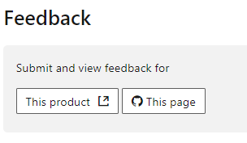

How can you contribute?
Make sure this isn’t a support issue or product bug
Docs issues address the docs – not a convention or condition
Product feedback: “This product” feedback.azure.com
Notes:
To be clear, support issues don’t belong in document feedback. Similarly, the Product Feedback channel is also not for support issues. The feedback options we’re about to discuss are not Microsoft Support and has no SLA for response time. If you’re having a problem or unexpected behavior or an outage, contact Microsoft support or your support partner. Only Docs issues belong in Github, and perhaps, after you’ve resolved your support problem you could contribute to the solution! We triage incoming issues and PR’s from Github and if it sounds like a support issue, your issue will likely be closed up with a polite message and perhaps some links. <click>
Most of the good Docs issues that get attention are a request to fix something missing or outdated or wrong, that’s good, or, a request to add something that would have helped prevent an error, outage, etc. <click>
If you’ve got an issue, how to submit it really depend on you. Three main options.
First, if you have product feedback or suggestions, or reproduceable bug reports, that doesn’t belong in the Docs system, that’s for support or, you can use the feedback tool. If you have been around a few years, you might remember the Connect system with Connect items. A few years ago those were migrated to the feedback.azure.com portal. That’s the place for comments and suggestions for the products. That’s external to us, but that’s where a lot of great useability ideas and bug reports come from, and it’s open to the public.
<click for screenshot>

Slide 19
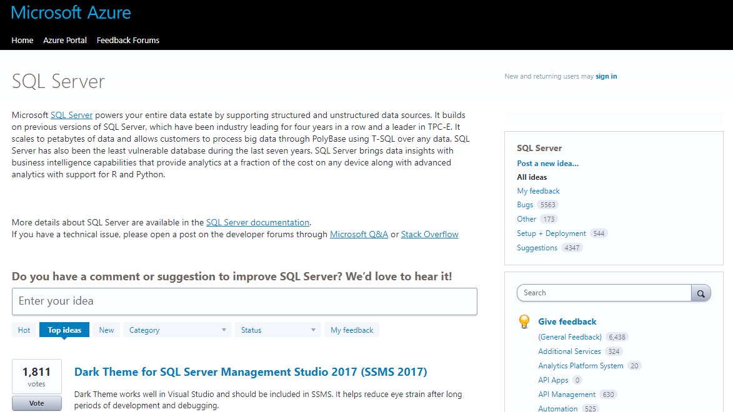
Feedback on feedback.azure.com
Notes:
This is the SQL Server page of https://feedback.azure.com/ where you can submit comments or suggestions and vote on ideas. You might see a lot of these on social media for when someone has a good suggestion and wants to get the product team’s attention with a lot of votes in favor.
This isn’t Docs, so this isn’t reviewed by our Docs team – but rather directly by the product engineer teams. This is the place for your comment or suggestion or idea if it doesn’t fit into a documentation issue.

Slide 20
How can you contribute via an Issue?
Product feedback: “This product” feedback.azure.com
GitHub issue: “This page” github.com/MicrosoftDocs
Notes:
<click>
So, let’s say you know you’ve got a documentation issue to suggest.
If you’ve got a conceptual issue, or a request for additional content you don’t have, you can simply put in a Git issue for the article.
This of this as letting us know, something’s wrong here, you go fix it.
We have goals to address these issues in a timely manner with some tracking of these internally, but we’ll be honest, issues are triaged and might take days or weeks to get a satisfactory resolution.
Not all issues become a documentation change immediately, or ever, depending on what the issue is. Sometimes we’ll close an issue if it has internally become a work item for a product team, for example.
To create an issue, use the “This Page” button you see at the bottom of a page. That brings you to the Github page where you’re given an easy template to file a report about whatever you want to raise. <click for screenshot>

Slide 21
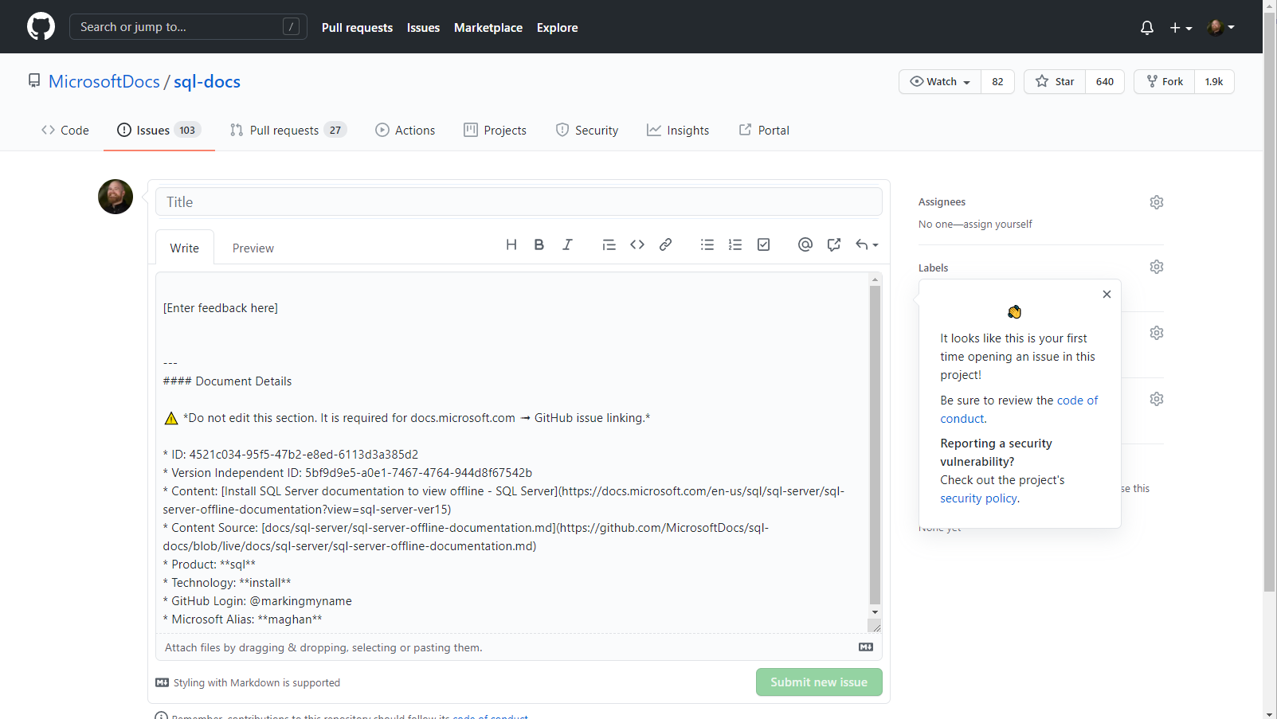
New Github Issue
Notes:
Here’s the new issue screen after you’ve logged into Github. Throw your comments in here and “Submit new issue”, and we’ll take it from there.

Slide 22
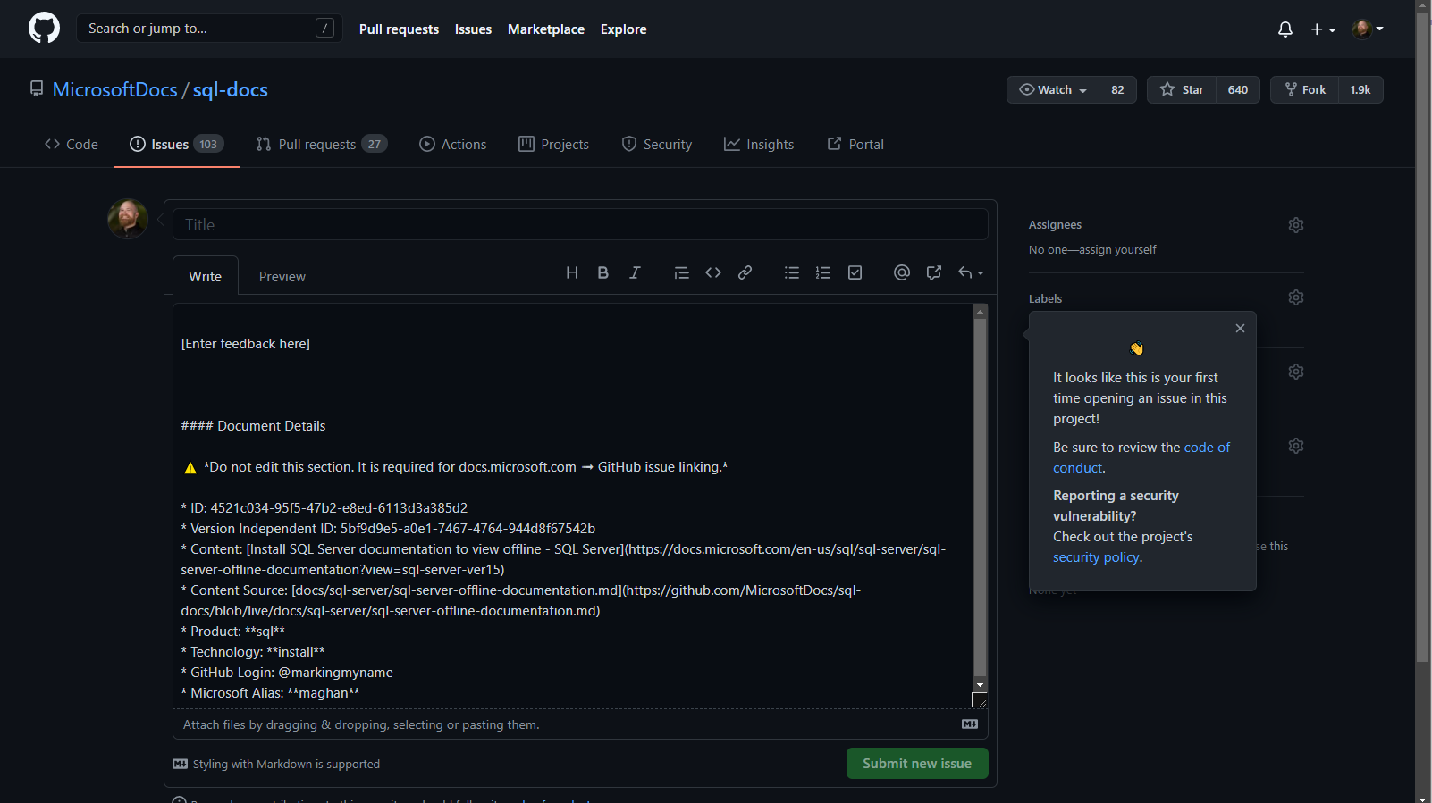
New Github Issue, Dark Theme
Notes:
And if you weren’t aware, Github has a dark mode! It’s very nice!

Slide 23
Github Dark Theme
Notes:
You can change this in your Github settings, or when logged in, head to your Github profile page.
Who hear tries to work in dark themed apps and websites as much as you can?
<!!!pause a moment for the gif to show the light to dark mode animation. It loops. You can then move on.>

Slide 24
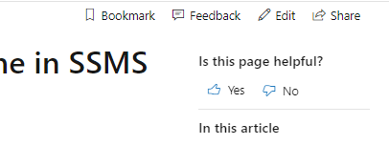
How can you contribute via a PR?
Product feedback: “This product” feedback.azure.com
GitHub issue: “This page” github.com/MicrosoftDocs
You want to edit yourself via a GitHub Pull Request
Notes:
Third option, you’ve got a documentation issue and you want to suggest the edits yourself into the markdown of the documentation, to fix a sentence or typo, or add a link, you can click on the “Edit” button in the top right-hand corner. Now this works like any Pull Request in Github does. Your changes to the markdown of the file will be proposed for merge, triaged, and reviewed by the article author and reviewers. The content team for the article takes it from there, replies in the PR comments, makes edits if necessary, and merges the code in. You’ll be notified along the way with feedback directly from one of us on the content team. <click for screenshot>

Slide 25
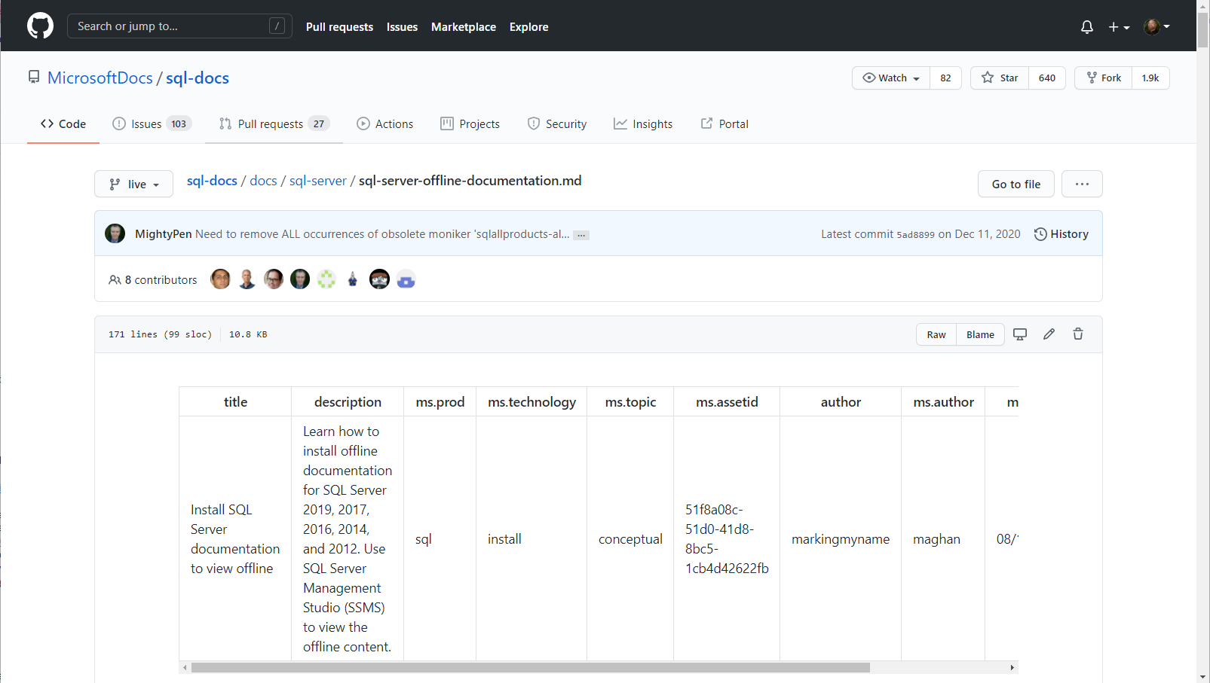
Github Edit article Top
Notes:
Clicking the Edit button on a doc brings you to the Github preview page for that article. From here, click the Pencil button on the top right header bar, boxed in red.

Slide 26
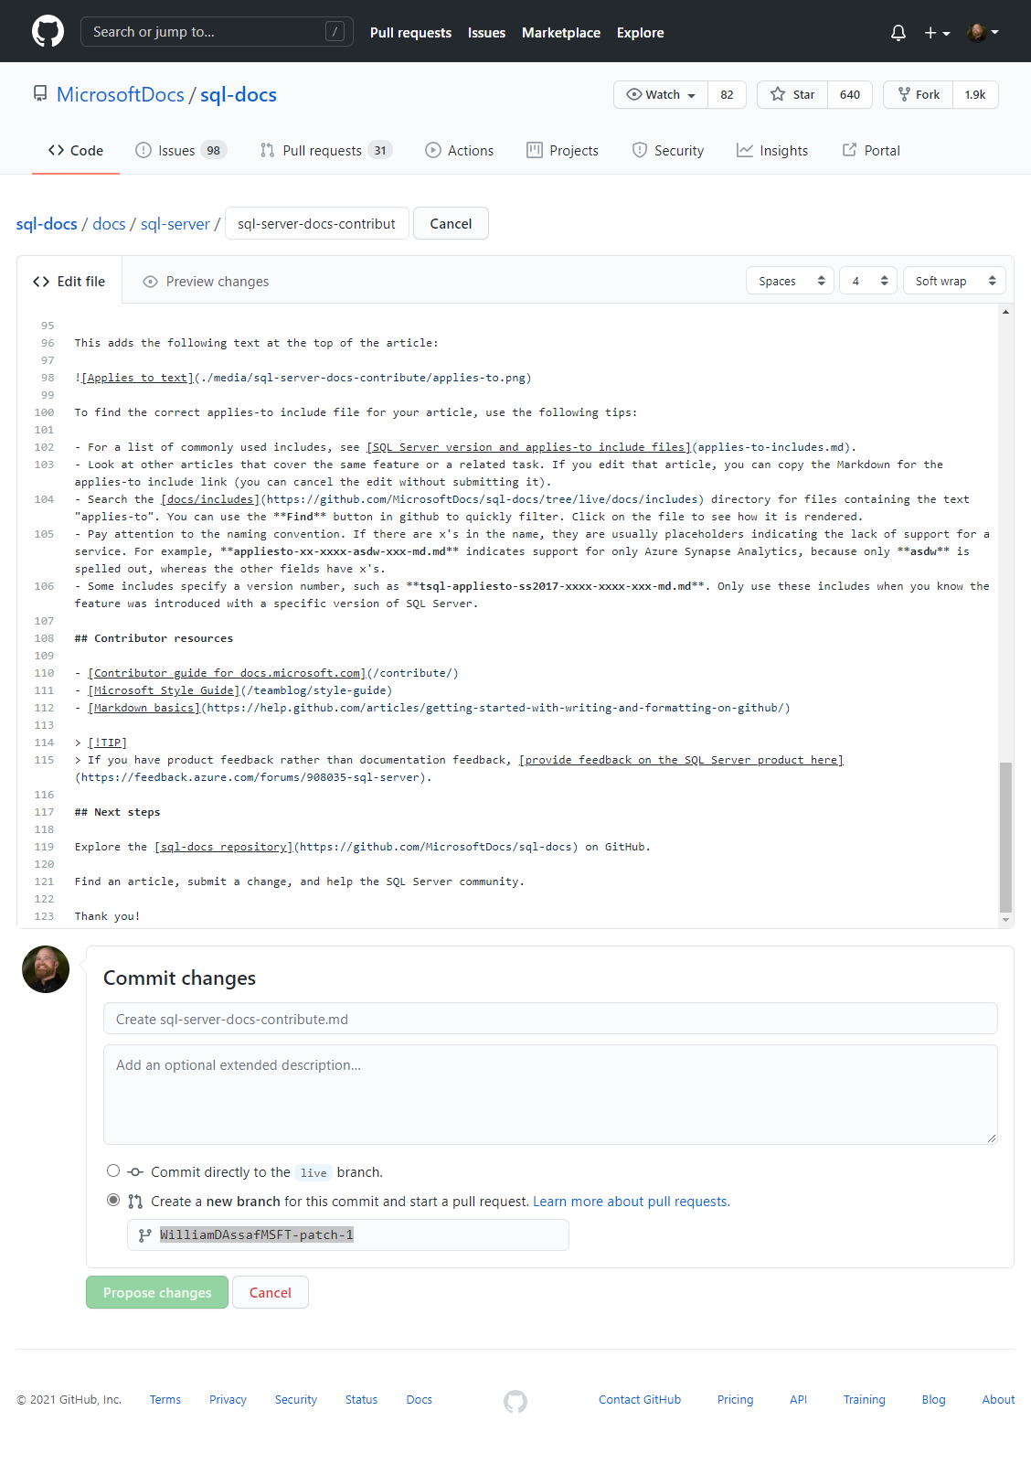
Github Edit article
Notes:
After you click the pencil button, now you’re looking at the actual code in a text edit box.
Make your changes here! If you’re not familiar with markdown, it’s pretty easy to understand once you get rolling, and don’t worry about it being perfect. The Content Team will always review your content submission and potentially tweak it to Microsoft standards before it is merged live. There are plenty of resources online for basic markdown syntax, but if you don’t get something quite right, don’t sweat it.
You can use the Preview changes feature to preview the markdown formatting.

Slide 27
Github Edit article bottom
Notes:
Once you’ve made your changes in the edit box, scroll to the bottom. Here you have a chance to commit your changes.
Enter your PR title and comments, then choose the “Create a new branch for this commit and start a pull request” radio button. Unlike some open source projects, we won’t allow you to commit code to the live repository, ha!
You’ll notice it gives the new branch a simple name, but don’t worry about that.
If you’re not familiar with Github terminology like branches and pull requests, don’t worry, you don’t have to be! Once you submit your Pull Request by clicking the green “Proposed Changes” button, we’ll take it from here and keep you updated as your PR moves through the process.
Again, you can do all this if you want through your own tooling, to create your own fork, branch, commits, push and Pull Request. That’s what we on the Content Teams do every day. If you want to just use the Github.com website to handle the entire process for you, it’s much easier!

Slide 28
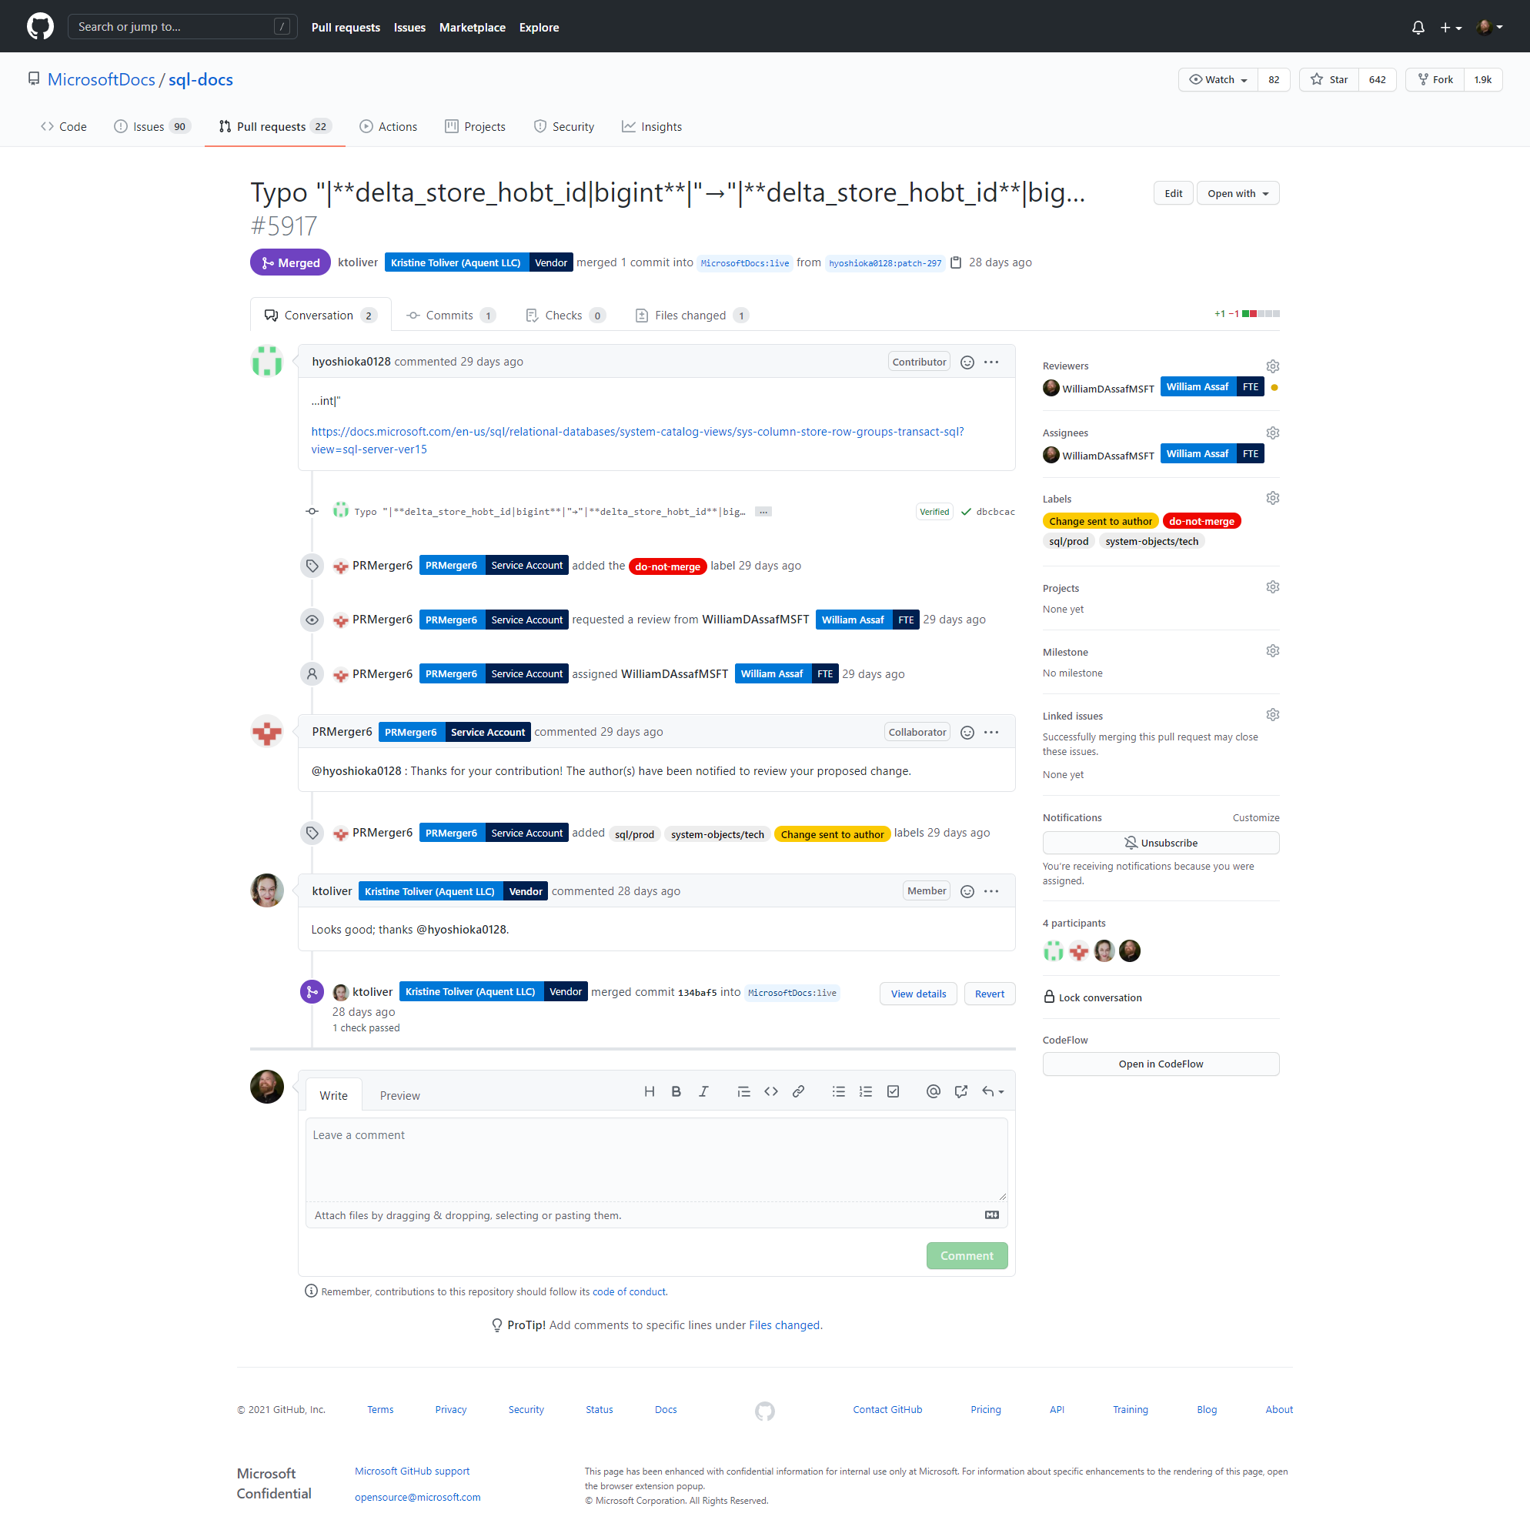
Pull Request Created
Notes:
Here’s what it looks like after you’ve submitted your pull request.
Your PR will start in an Open status, but you can see this one is already Merged, which means it’s been accepted and pushed to preview repo, where soon it will be merged to the live production repo.
(For reference: Typo "|**delta_store_hobt_id|bigint**|"→"|**delta_store_hobt_id**|big… by hyoshioka0128 · Pull Request #5917 · MicrosoftDocs/sql-docs (github.com))

Slide 29
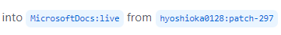
Pull Request Created 1
Notes:
You can see what Github did for you was to automatically in the background create a fork, create a branch in Hiroshi’s name.
<click>
and the pull request includes the commit, which is in the PR log right here with the red arrow. Pull Requests can include many commits for many different files.

Slide 30
Pull Request Created 2
Notes:
The PR log contains both automated and manually created messages, automation for the merge engines, all commits, and conversation and notes from anyone assigned.
You’ll receive an email anyone uses your username with an @ symbol, and you can respond in conversation at the bottom here with the comment button.

Slide 31
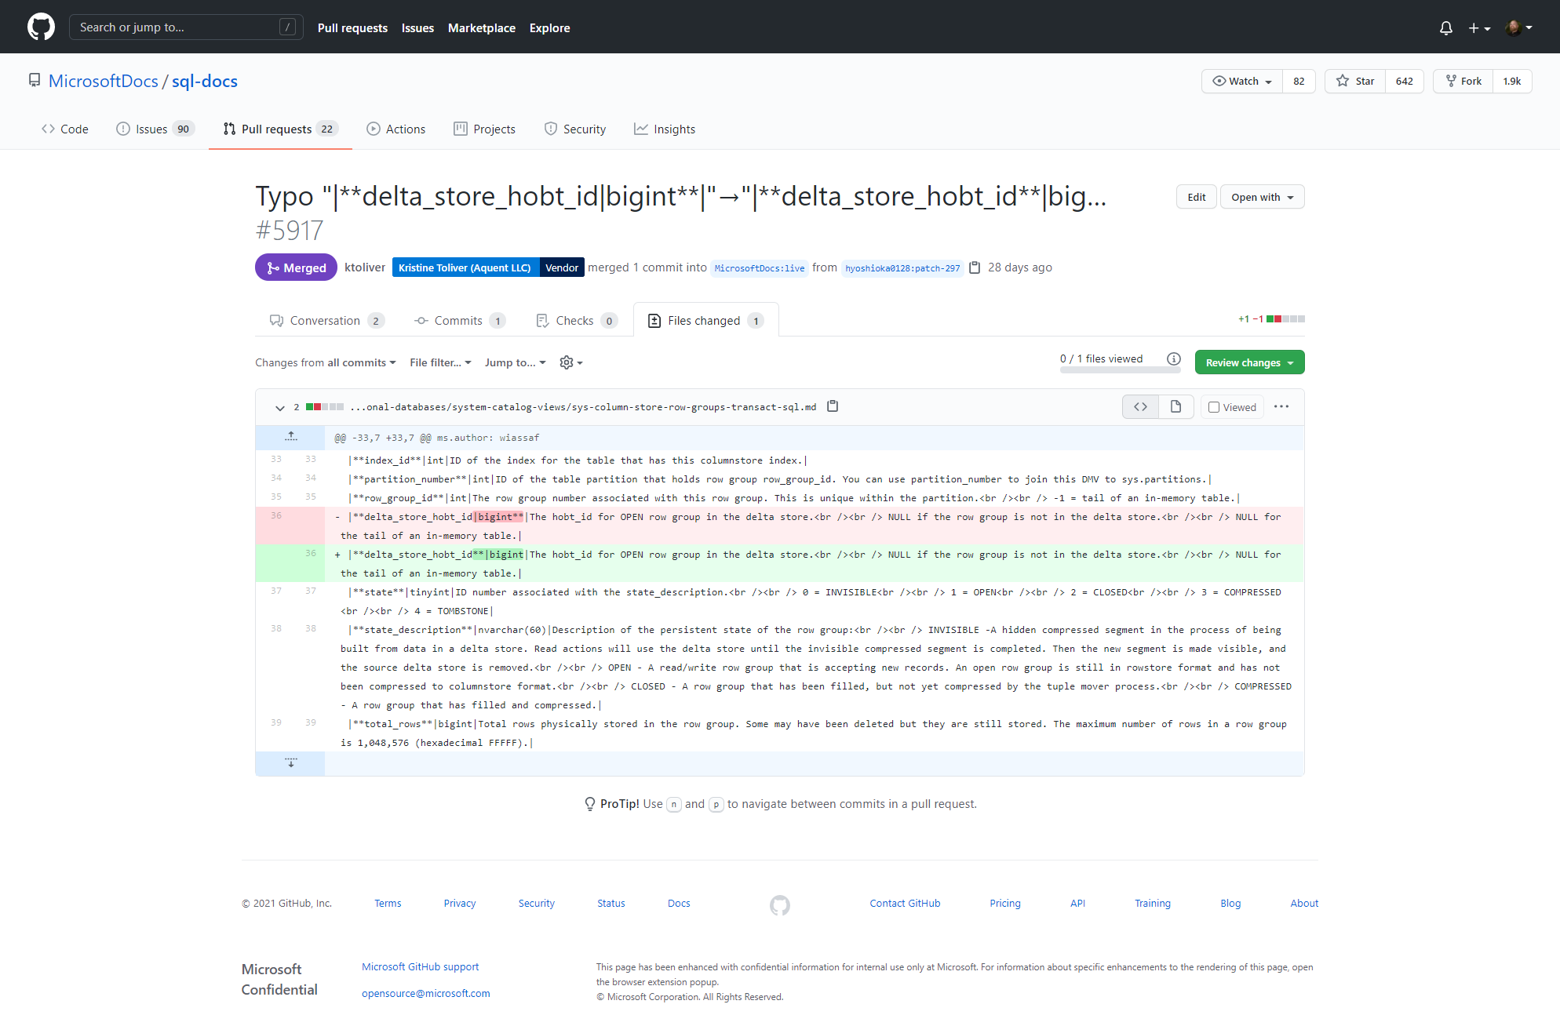
Pull Request Created 3
Notes:
Once your Pull Request is created, both you and Microsoft can review the changes you’re suggesting in the Pull Request.
Click on the “Files Changed” tab to see an in-browser differential. Red is the old code line, green is the new, and the changed characters are highlighted. Here we can see someone has suggested a typo fix, easy to approve.

Slide 32
Pull Request Created 4
Notes:
If you still wanted to make more changes to the file, you can issue another commit to the pull request, simply click on the three dots icon here and click Edit file. Then you can submit another change to your same pull request.
After you’ve submitted your PR, it’s in Microsoft’s hands now, and you can sit back, we got it from here and will let you know if we have more questions, or have a status update.

Slide 33
Wrapup
Product feedback: “This product” feedback.azure.com
GitHub issue: “This page” github.com/MicrosoftDocs
You want to edit yourself via a GitHub Pull Request
Notes:
So those are your three options!
A couple important notes here.
Not all articles have a feedback or edit buttons. We haven’t enabled this workflow for some document types.
The documentation feedback button is not Microsoft Support and has no SLA for response time.
Now, what’s most helpful for Microsoft, and what’s gives you contribution credit? The third option, a Pull Request. That’s what we want to see.

Slide 34
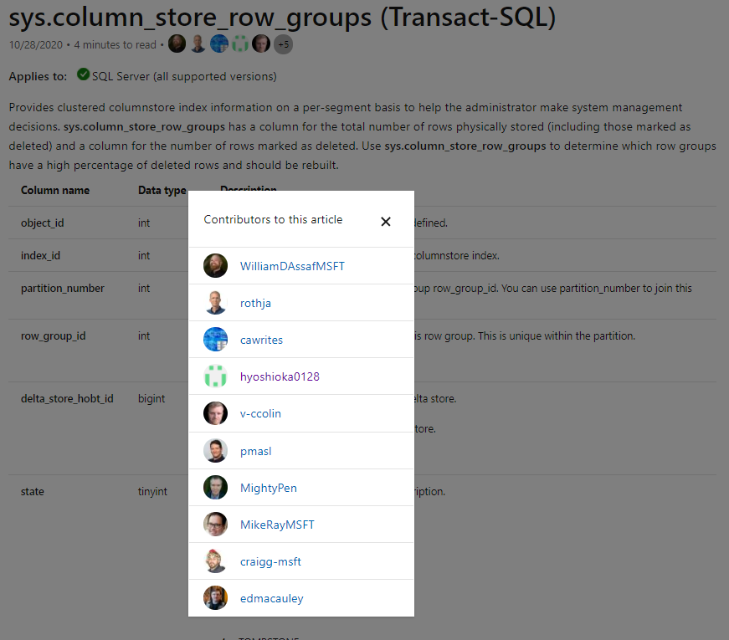
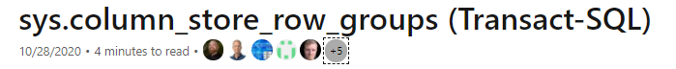
Credit Due!
Notes:
If you contributed via a Pull Request, and we merge your PR into the document, you’ll get your Github pic and a link to your profile at the top of the document! The folks listed here are those inside Microsoft and external that submitted pull requests to an article.
Now, you only get your name and logo on an article for a PR, not just for an issue.

Slide 35
Don’t be Afraid to Submit a PR!
If you're not sure how it should change, give it a shot.
Bulk updates across many files? We got it.
Image or graphic needs to be updated? We got it.
Capitalization iS tOuGh. We get it.
Azure SQL Database vs a database
Azure SQL Managed Instance vs a SQL managed instance
Notes:
If you're not sure how it should change, give it a shot.
If it’s not quite right, or formatted perfectly, don’t worry! We’ll adjust, but at least it gets fixed!
<click>
For bulk changes like capitalization or naming conventions, we have better ways of searching and editing those, so let us handle.
We’ve had folks issue Pull Requests with hundreds of changes for capitalization or punctuation changes, half of which were incorrect.
Instead, maybe just issue a PR for one file, and make notes.
<click>
For images, graphics, charts, etc., we have designers to use to get images updated in a standardized way. No need to edit images yourself.
<click>
Finally, capitalization of various features and products inside Microsoft is one of the most nuanced bits there is about publishing. Marketing usually wins these arguments, regardless of how a product documentation evolved throughout its development process.
Just had a big PR come thru to make a lot of capitalization changes that were mostly misguided, so again, that task is tricky enough when you have information directly from the inside sources, we’ll handle that part. And yes, if you spot inconsistencies between marketing content and documentation content and training content, you should know we’re regularly discussing and working on that stuff internally, and don’t be afraid to point something out.
<click>
For example, product names and feature names and phrasing are difficult to get just right, and are trickiest when a generic word is in the product name. Just because we have a product called Azure SQL Database, doesn’t meant that every word Database is now capitalized.
Azure SQL Database vs a database
Azure SQL Managed Instance vs a SQL managed instance
This is even more difficult for our international partners and customers, because capitalization usually means a product or service name shouldn't be translated, but lower case common noun of the same term should be translated. Inconsistency in capitalization confuses translators and customers.
So that consistency is important, and so are the core goals of our brand voice: Above all, be simple and human. If we can do better to meet that goal, let us know!

Slide 36
GitHub Hosts Microsoft Docs
Notes:
So, now that you’ve seen how you can use Github to contribute to Docs, let’s briefly show you some inside baseball and talk about how we use Github to host Microsoft Documentation.

Slide 37
Docs Behind the Scenes
Docs are markdown or yaml
VS Code or Azure Data Studio, Git, Github
Rich metadata and SEO tracking, Kusto queries
Managed through custom build processes
Release branches for big, timed doc releases
Notes:
It might surprise you to learn that Microsoft Docs are not edited Microsoft Word documents, but rather in code, in markdown or yaml.
Markdown is a lightweight text markup language created for formatting rich text with a plain text editor. Github has their own formal implementation of markdown called GitHub Flavored Markdown. Many different online sites use markdown for their content, including GitHub, GitLab, Reddit, Stack Exchange, BitBucket, Drupal, and more.
YAML is another plain text markup language that’s often used for configuration files. It behaves much like XML, is indented like Python, and has formatting features from JSON. It’s used less for displaying article text and more for structured content like tables of contents and FAQs, both of which work better for SEO in YAML.
<click>
Most articles are in markdown, and we spend most of our time using Visual Studio Code or Azure Data Studio to edit them. And yes, we on the SQL Docs team work in SSMS and Azure all day too.
We have other tools to help with automated link checking, syntax formatting, bulk updates, and a series of include files to tokenize things like product names.
<click>
We have a rich set of metadata for each article and traffic tracking and do pay attention to how articles perform in terms of Search Engine Optimization and traffic patterns and trends, all driven through Azure Analytics and custom Kusto queries. We try to improve poorly performing articles, break up articles that are too varied in topic. We use many metrics to track the performance of an article including, for example, if you copy text from the article, that’s good! Or if you click through, scroll, dwell, the same kind of metrics that any website uses these days to measure how effective the web page is, without capturing any personal information or wider tracking information.
<click>
Everything is pushed through Github and built multiple times per day, with our own custom build processes and repositories. We have folks on the team who are very good at Git, and we have a robust release management process behind the scenes. We’ll talk more about that.
<click>
For big article updates we have systems to handle release branches – for when we want to work on documentation for months and then release a new product all at once, like during Ignite.

Slide 38
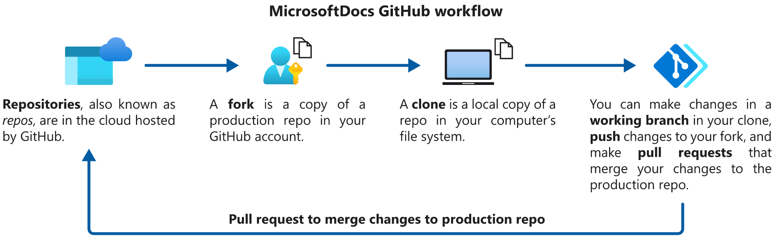
GitHub Basics
Notes:
Here’s some behind the scenes of how Microsoft Docs in Git works, specifically in Github, where all Microsoft Documentation is managed. If you are new to Git and don’t understand this don’t worry, as we’ll explain, to contributors in the community, all this is managed for you.

Slide 39
GitHub Basics 2
Upstream Origin Local
MicrosoftDocs/ sql-docs
username/ sql-docs
username/ sql-docs
username/ sql-docs.
20210215-fix-issue
Pull Request
Push
Commit
Notes:
This may be a bit of a deep dive, but for those of you who work in Github, this might be interesting inside info.
A repository, like SQL-Docs, is where the source is housed and where the website engine pulls markdown to present the live pictures to you in websites.
<click>
A fork is a copy of the repo associated to your account up in Github. We each have created forks of the repo in our Github accounts.
<click>
A clone is a copy of a fork brought down locally, the files copied on to your workstation, so you can make edits. To tell the two apart, a common convention is to reference your remote fork as Origin, and the codebase you eventually push to called Upstream. These are called Remote names or Remotes, and these are just common naming conventions, you can choose any name. You’ll have an origin and an upstream for each repo you work in.
<click>
When you go to make changes to a file, or to add or remove files, you’ll create a working branch that is relevant to the chunk of changes you’ll be making. You want a branch to contain only the changes for a specific feature or issue you’re addressing, so that it can be treated as a block of changes to go back up the stream.
<click>
First the branch is committed locally,
<click>
then pushed to your Origin in Github.com, the fork of the code in your account.
<click>
Then, you issue Pull Request, asking the MicrosoftDocs repository to accept changes from your repository, so that your changes can be meged from your Fork into the Main repository.

Slide 40
GitHub Basics 3
Live Upstream Origin Local
MicrosoftDocs/ sql-docs
MicrosoftDocs/ sql-docs-pr
username/ sql-docs-pr
username/ sql-docs-pr
username/ sql-docs-pr.
20210215-fix-issue
Automated Build
Notes:
To explain things a little closer to the reality to how we work internally, we actually have two repositories in the MicrosoftDocs account. You don’t have to worry about this, if you’re submitting PR’s outside of the browser.
The SQL-Docs repository drives the website, but like true professionals, we don’t develop against production!
We only develop in the Preview repository, which is not visible to the public, and allows us to work in and Preview the merged state of our changes in the actual live repository. This build process to the live website occurs usually twice a day and is gated by a team of build reviewers.
<click>
But to bring us full circle, when you contribute to docs, you contribute to the live repo, only. And again, you can do this entirely through the browser. If you want to use your own tools to contribute, you don’t have access to the Preview repository, only the public repo. Once your PR is filed, we take it from there!
Any questions about how this works?

Slide 41
What’s New in SQL Docs?

Slide 42
MVPs: Docs and Learn Champion
MVP creator ID’s for links to Learn and Docs content
Ex: https://docs.microsoft.com/azure/azure-sql/virtual-machines/windows/sql-server-iaas-agent-extension-automate-management?WT.mc_id=DP-MVP-5003697
Over 1000 MVPs are registered to participate (as of Oct 2020).
Works also for sites: azure.Microsoft.com, channel9.msdn.com, cloudblogs.Microsoft.com and more Microsoft sites.
Contact mvpdocschampion@microsoft.com
Notes:
For MVPs, the Docs and Learn Champion program gives you a unique code to append to links to Microsoft Learn and Docs content in your blogs and social media. This is a WebTrends code that can be appended to links to help measure referrals from your content.
As a participant, you have the option to get a personalized report of your contribution analysis as part of the program, contact your MVP Program Manager or mvpdocschampion@microsoft.com for more information.

Slide 43
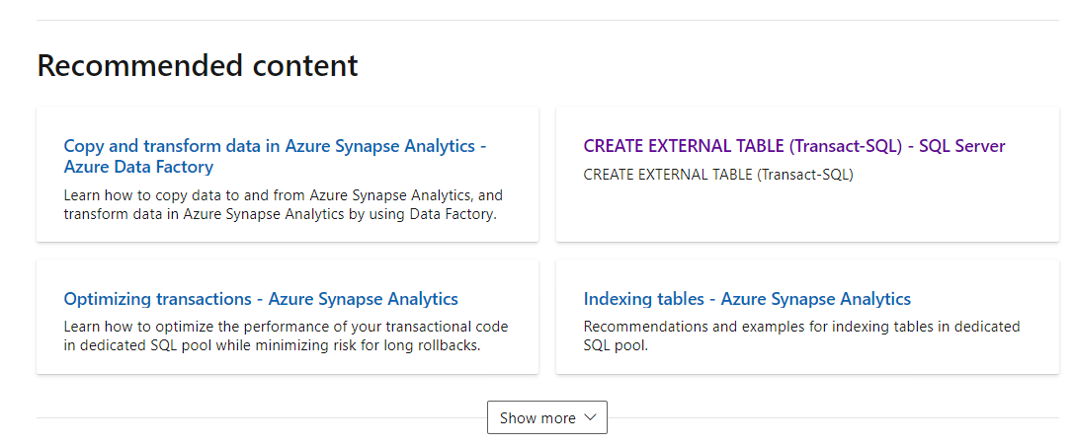
Recommended content in footer
Notes:
In February 2021 we introduced dynamic recommended content in the footer of many Microsoft Docs articles.
The links in the content are determined by a machine learning solution based on a model that describes customer behaviors with our documentation set.
We’ve seen really positive feedback on tracking traffic to recommended files so far, based on the metrics, we this this is pretty helpful.

Slide 44
Azure SQL rebrand and reorganization
https://aka.ms/azuresqldocs
Previous term | New term
Azure SQL Database Managed Instance | Azure SQL Managed Instance
Azure SQL Database single database | Azure SQL Database
Azure SQL Database elastic pool | Azure SQL Database
N/A | SQL Server on Azure VMs
N/A | Azure SQL
Notes:
<TODO: What’s the latest here?>

Slide 45
Azure Arc enabled data services
Preview release at Ignite 2020:
Azure Arc enabled data services (preview):
Run Azure data services on-premises, at the edge, and in public clouds using Kubernetes and the infrastructure of your choice.
Azure Arc enabled SQL Server (preview):
Extends Azure services to SQL Server instances hosted outside of Azure in your own datacenter, on the edge, or in a multi-cloud environment.
Part of the hybrid story provided by Arc all-up.
Notes:
<TODO: What’s the latest here?>

Slide 46
Azure Data and Analytics Digital Event
Join an upcoming Azure Data and Analytics Digital Event
https://azuredataandanalytics2020.eventcore.com/auth/login
Notes:
<TODO: Next upcoming event>

Slide 47
Open discussion… Your feedback on SQL Docs
Notes:
List of questions for discussion here (anyone can ask these):
Did you notice the edit feature? Has anyone edited articles before?
What do you like about the documentation today?
What could be better?
Which of these features and tips are the most surprising or helpful?
How do you most find the things you need in the documentation?

Slide 48
Thank you! Reach out to us on Twitter: @SQLDocs

